Slide 1
Regression with Statcast: Modeling How the Changes in the Approach of Major League Batters Is Affecting Batted Ball Outcomes

Slide 2
If you’re 10 years old and your coach says to get on top of the ball, tell them no. Because in the big leagues these things that they call groundballs are outs. They don’t pay you for groundballs. They pay you for doubles. They pay you for homers.
Josh Donaldson
2015 American League MVP

Slide 3
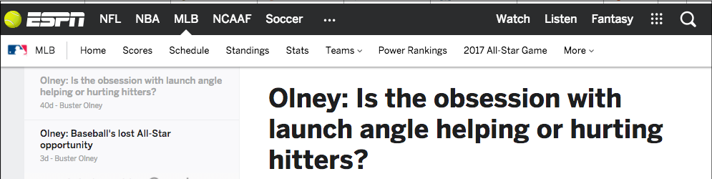
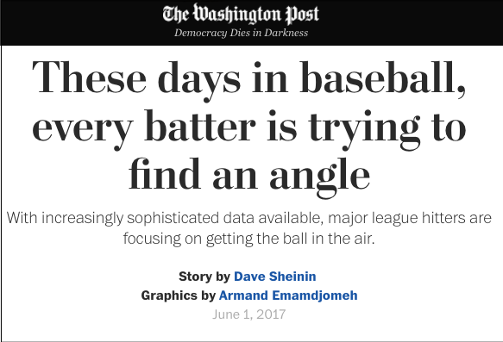
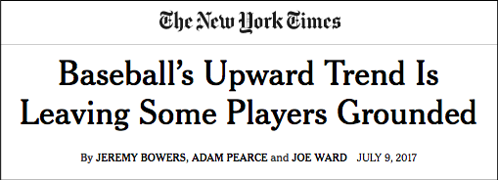
June 4, 2017

Slide 4
1. Introducing Statcast
Big data is changing Major League Baseball

Slide 5
What is Statcast?
Statcast is Major League Baseball’s camera based analytics system.
It can instantly track and record:
Pitch speed
Pitch spin rate
Pitch location
Speed of ball off bat
Angle at which ball leaves the bat
Even more!

Slide 6
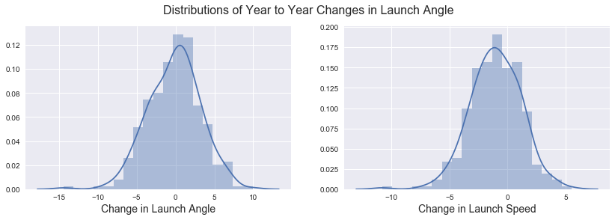
How are batters changing their swings?
In the Statcast era, batters’ year to year launch angle has increased. Batters’ launch speed has declined slightly, probably due to aging.

Slide 7
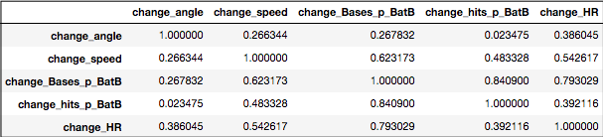
Correlations
Increasing the speed of the ball off the bat is the best way to improve hit or homerun rates, but that’s hard. Changing launch angle can lead to more homeruns, not necessarily more hits.

Slide 8
Question:
Are Major League batters’ adjustments leading to better performance?

Slide 9
2. Modeling
Exploring the relationship between swing adjustments and outcomes

Slide 10
The Data
Use Statcast data for all available years (2015 - 2017) to find the following for each Major League batter:
Explanatory Variables
Change in average launch speed
Change in average launch angle
Response Variable
Change in hits per batted ball
Restrict data to only batters who have qualified for the batting title* in a year to limit random noise (303 player seasons)
*3.1 PA ✖️ number of team games

Slide 11
Initial Regression Models
 | Test r² by Poly Degree
Change in: | 1 | 2 | 3
Hits per Batted Ball | .05 | .13 | .19
Change in Homeruns per Batted Ball | .41 | .44 | .46
Initial results indicate some small but significant relationship

Slide 12
Increase in launch speed + angle
Increase in launch speed only
Decrease in launch angle
Third-degree regression model
with Ridge cross - validation
Reject!
Homeruns per batted ball

Slide 13
Increase in launch speed + angle
Increase in launch angle only
First - degree regression model
with Ridge cross - validation
Homeruns per batted ball

Slide 14
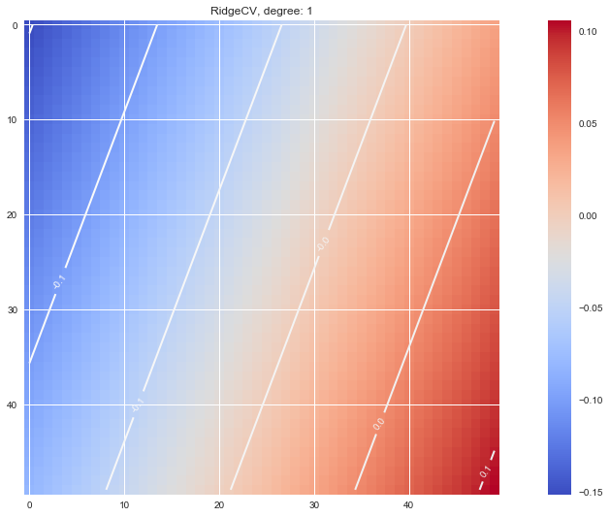
Evan Longoria
 | 2016 | 2017*
Avg | .273 | .259
Slg | .521 | .427
HR | 36 | 12
Change in Launch Speed
Evan Longoria 2017
Change in Launch Angle
*Through 87 games

Slide 15
Anthony Rendon
 | 2015 | 2016
Avg | .264 | .270
Slg | .365 | .450
HR | 5 | 20
Change in Launch Speed
Anthony Rendon 2016
Change in Launch Angle

Slide 16
3. Reflecting
Looking for potential improvements to the model

Slide 17
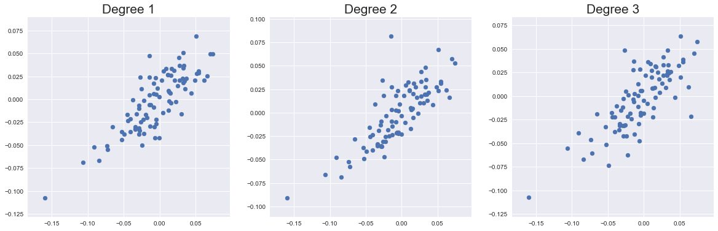
Residuals?!
Linear Regression is almost certainly not the best tool build this model

Slide 18
Other possible variables
Ballpark
The optimum approach will vary greatly between Coors Field in Denver and Petco Park in San Diego
Horizontal Angle
Players who are able to use all fields will have more hits per batted ball.
Previous Year’s launch angle
Neither this or previous year’s launch speed improved model performance measureably

Slide 19
thanks!
Any questions?
Special thanks to:
To Devin for help finding the data
To Jen for recommending SlidesCarnival
?

Slide 20
Credits
Special thanks to all the people who made and released these awesome resources for free:
Presentation template by SlidesCarnival
Photographs by Unsplash

Slide 21
Presentation design
This presentations uses the following typographies and colors:
Titles: Roboto Slab
Body copy: Georgia (system font)
You can download the fonts on this page:
https://www.fontsquirrel.com/fonts/roboto-slab
Dark gray #111111
Light gray #999999
Red #ff0000
You don’t need to keep this slide in your presentation. It’s only here to serve you as a design guide if you need to create new slides or download the fonts to edit the presentation in PowerPoint®

